Slide 1

Network Technologies
Lecture 1
Bamma Ravind

Slide 2

Introduction to networking
Agenda:
Introductions
Syllabus
Class rules
Expectations
Packet Tracer
Lecture 1
Labs
Practice Questions
Learning Methodology and resources

Slide 3
Network Technologies Lecture 1 Recap and Revision Lecture
What is a Network?
Logical vs Physical topologies
Functions of a Router and a Switch
Router or a switch.
LAN/MAN/PAN/WAN/Internet/Intranet/Extranet
OSI and TCP/IP model
Encapsulation
Connection Oriented vs Connectionless
Subnetting and IP Addressing
NAT
ICMP/ARP/DHCP

Slide 4
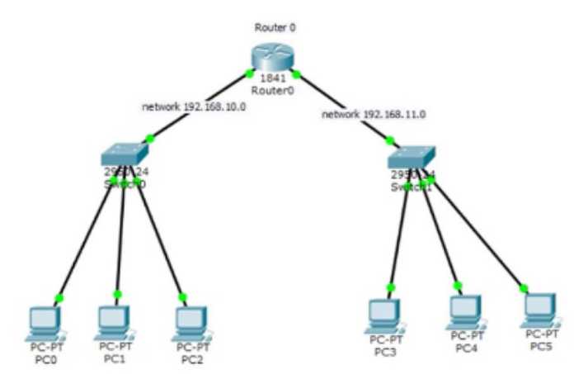
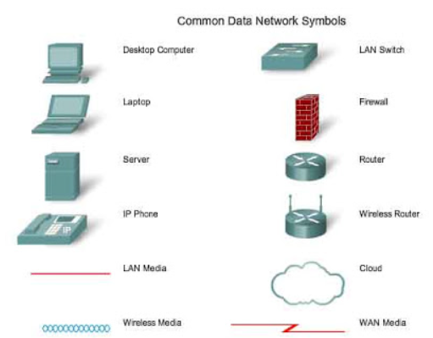
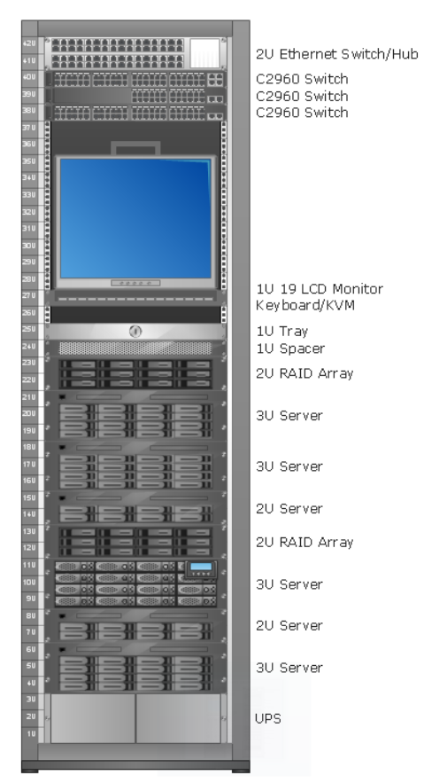
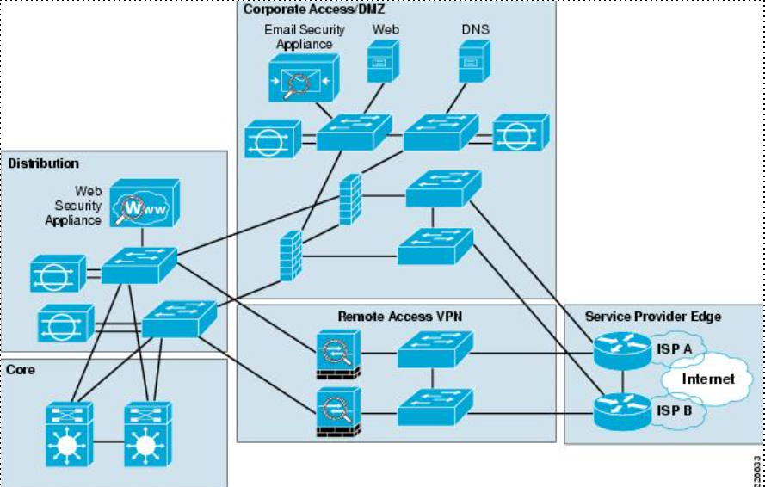
What is a Network? Sharing of resources

Slide 5

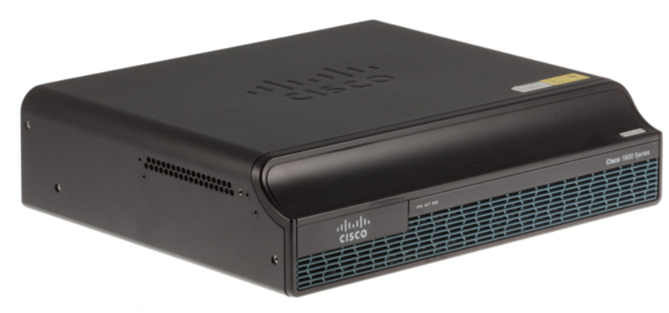
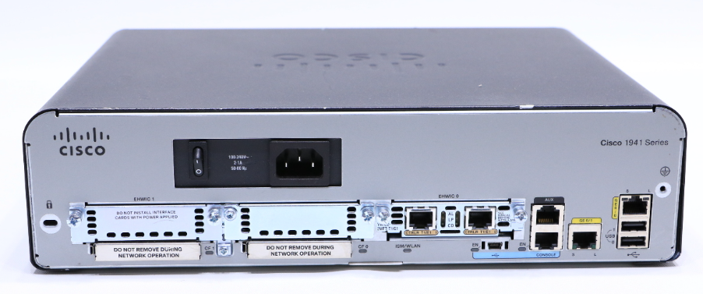
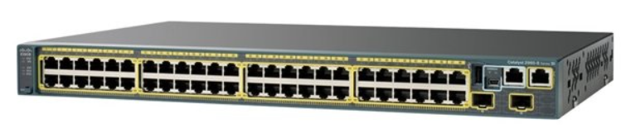
Functions of a Router: a. Finding the best path to a destination b. Connect different Networks Function of a switch: Forward packets Plug in your PCs, IP phones, access points, servers, firewalls etc Activity: Check out the Config Guide and Data Sheet of a router and a switch Types of ports
Source
Destination

Slide 6
How to Select a router or a switch? Or even an access point/controller?
Parameters to consider to select a switch:
Number of ports
Managed vs unmanaged
Layer 2/3
Uplink
POE
Fanless
Redundant power
Modular/Fixed?
Warranty / Smartnet
Support
Price
HP/Cisco Switch Selector
HP/Cisco Router Selector
HP/Cisco Access Point Selector
Firewalls?
Dlink?
Activity: A customer is looking for 2 proposals for a switch for an SME which has 20 users, his business is critical and cannot afford downtime. Needs POE for ip phones.

Slide 7
Types of Networks
LAN: connects a group of computers in a small geographical area.
MAN: covers relatively large region such as cities, towns.
PAN: interconnecting electronic devices in an individual person's workspace e.g smartphones
WAN: spans large locality and connects countries together. E.g Internet.
Internet /Intranet /Extranet

Slide 8
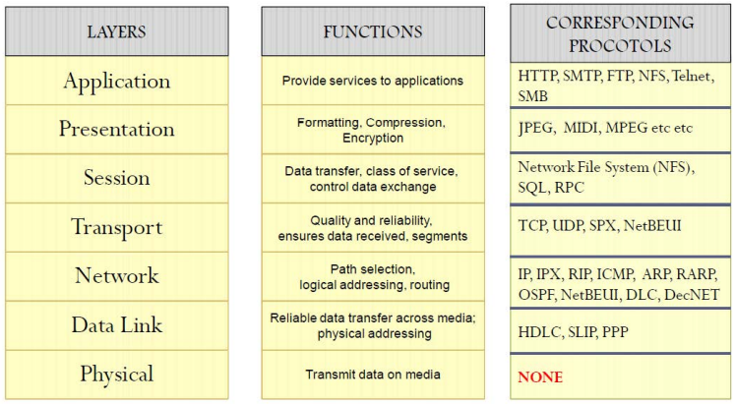
OSI Model
Encapsulation -
Eg post a package
Frame Check Sequence -

Slide 9
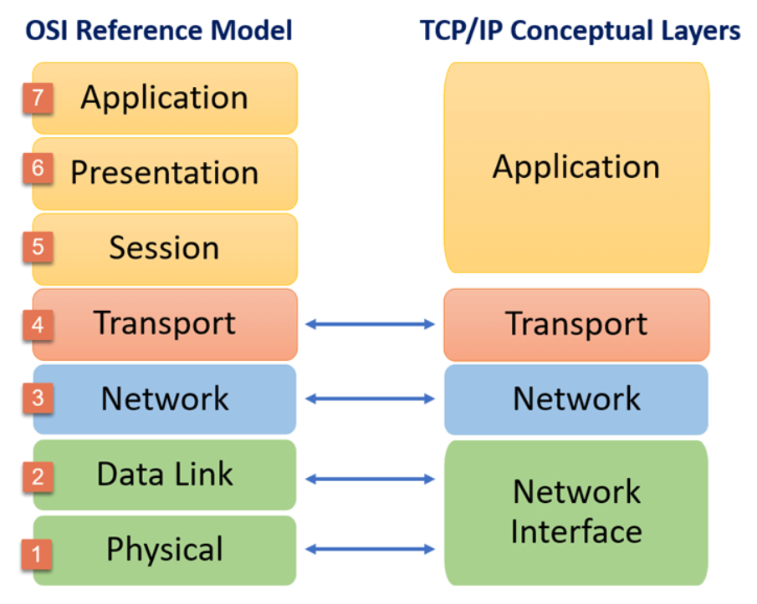
OSI and TCP/IP models

Slide 10
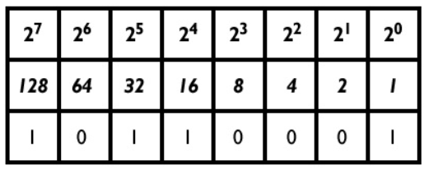
IP Addressing Decimal to Binary
What is an ip address?
Classes of ip addresses
Public vs private addresses
Subnet masks
Network, broadcast and range of usable ip address

Slide 11
Subnetting a. Finding Network Address b. Broadcast Address Range of usable IP addresses
10.0.10.0/24
165.96.201.37/26
65.26.20.15/34
175.32.80.117/22
0.38.90.86/16
200.0.256.80/28
192.168.100.200/26

Slide 12
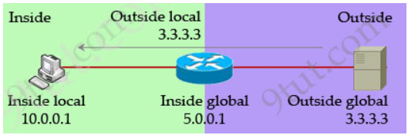
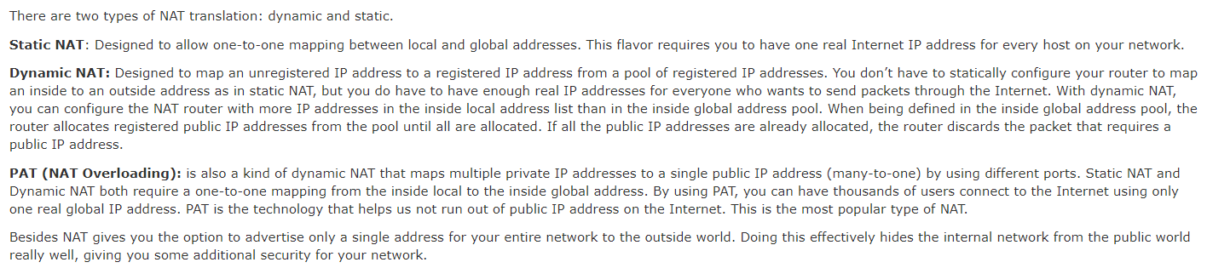
NAT Configure NAT – Static,Dynamic, NAT Overloading

